Slide 1

Moving to Australia, Which city is best for Arabic Food??

Slide 2
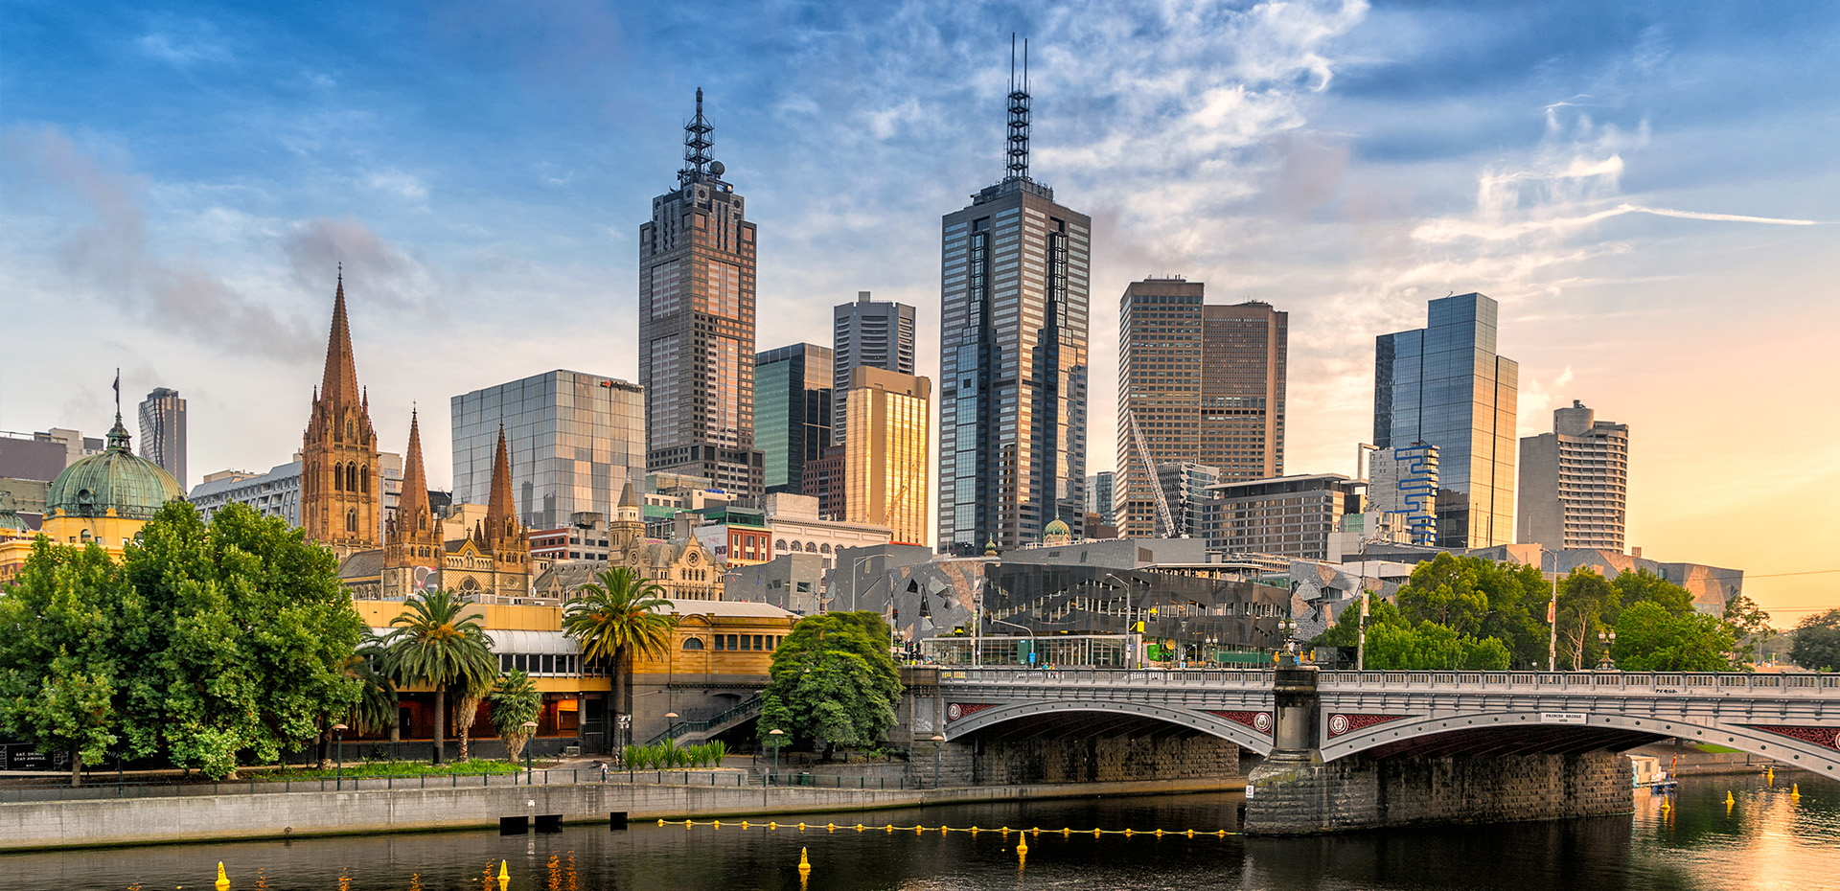
You Guessed Wrong
its Melbourne

Slide 3
We Solved this by Using Data Science
Extract All Arabic restaurants in each city using Foursquare APIs
Visualise the Maps using Folium Library in Python
We find the MDMC – Mean Distance of all the restaurants to the Mean Coordinates
And the Smallest Value of MDMC is the Winner which is Melbourne which has the Highest Density Of Arabic restaurants.

Slide 4
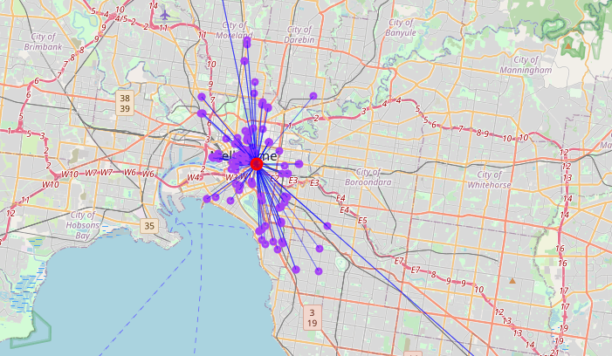

Slide 5
Everything is better when you spread it with Hummus.

